Slide 1

Improving Floating Solar Farm design
Acharya, Utsav – Computer Science
Evans, Daniel – Mechanical Engineering
Gilliam, Erica – Industrial Engineering
Harmeyer, Reese – Computer Engineering
Rockenbaugh, Carter – Mechanical Engineering

Slide 2
Overview
Background
Approach
Location
Materials
Mooring System
Detection System
Cleaning Robot
Review
Conclusion
Bibliography

Slide 3
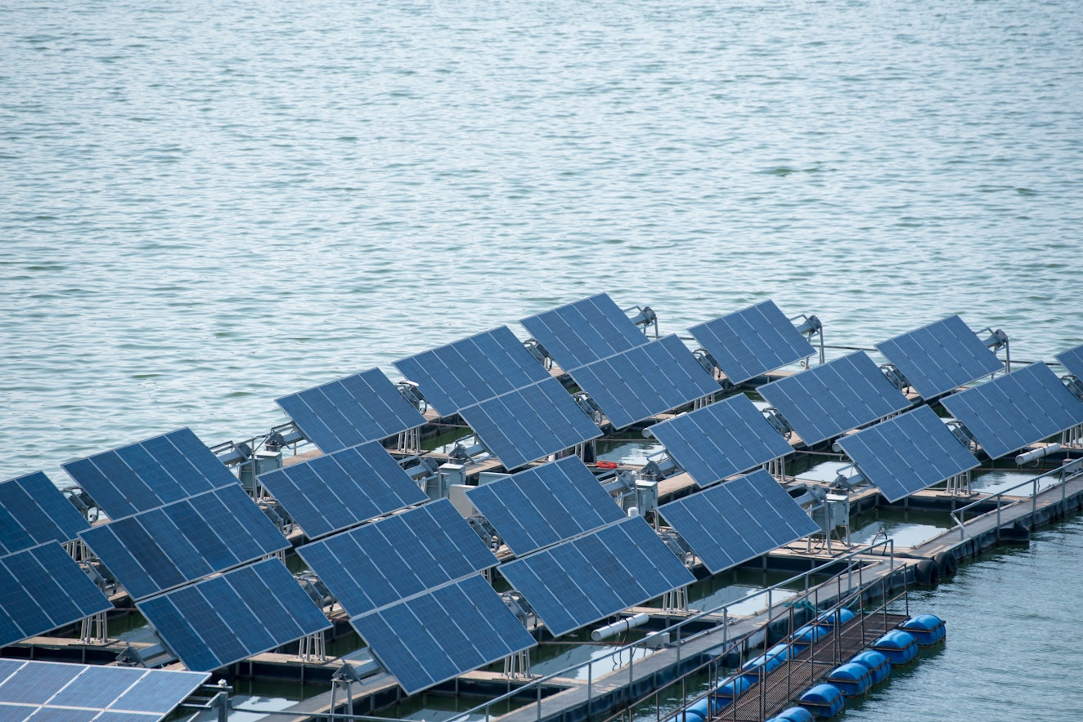
Background
Pros
Source of green energy
Land conservation
Efficiency improves
Floating solar farms must be designed to withstand harsh environmental conditions
https://ratedpower.com/glossary/floating-solar/

Slide 4

Location
No competition for land and larger areas
Areas with calm waters and close to shores for easier grid access
Areas with high sunlight, usually warmer climates, close to equator
Can integrate into existing marine infrastructure
https://www.worldbank.org/en/news/feature/2021/06/07/conserving-oceans-in-the-eastern-seas-of-an-indonesian-archipelago

Slide 5
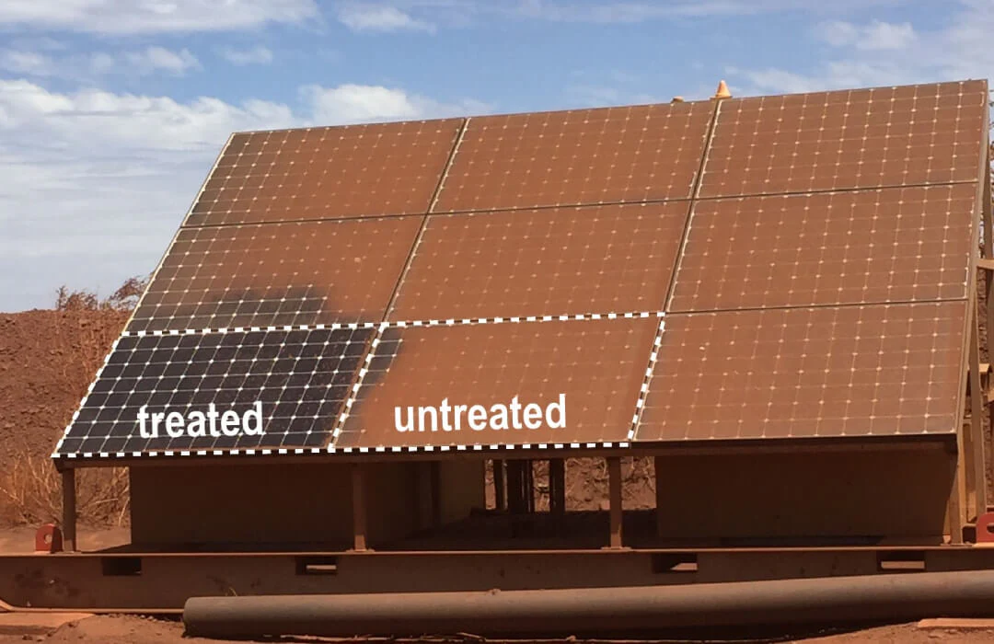
Material
Materials need to withstand ocean conditions
Protective layer will consist of:
High-density polyethylene (HDPE)
Modified epoxy glass coating
Structure will consist of:
Stainless steel
https://enduroshield.com/pages/protective-coating-solar-panels

Slide 6
Mooring System
Purpose:
Keeps floating platforms secure and stable
Prevents drifting and reduces structural stress
Extends lifespan of the platforms and solar panels

Slide 7
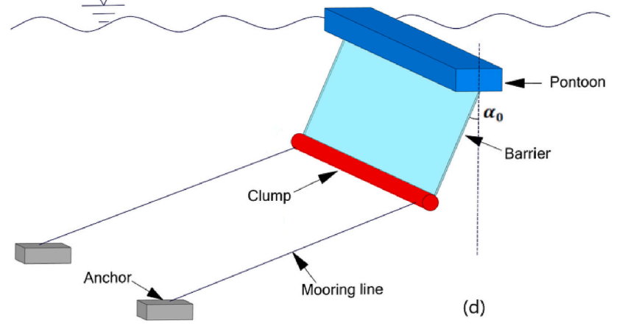
Mooring System Continued
Anchor
Provides a fixed-point for the platforms
Holds the mooring lines in place
Mooring Line
Allows for controlled movement
Reduces stress compared to rigid steel chains
Wave Barrier
Reduces incoming wave energy
Protects platforms from strong impacts
https://journals-ohiolink-edu.ezproxy.libraries.wright.edu/acprod/odb_ejc/r/ejc/search/99?p99_entity_id=305367581&p99_entity_type=MAIN_FILE&cs=3cZPIV-Lzhlv1iryKGV-u4EOTSkT3KXTQQ0mmyE08PeMleyfCRVQItHk9WPUzoJiB-wxlPZGakCDUumGgsxBPJQ

Slide 8
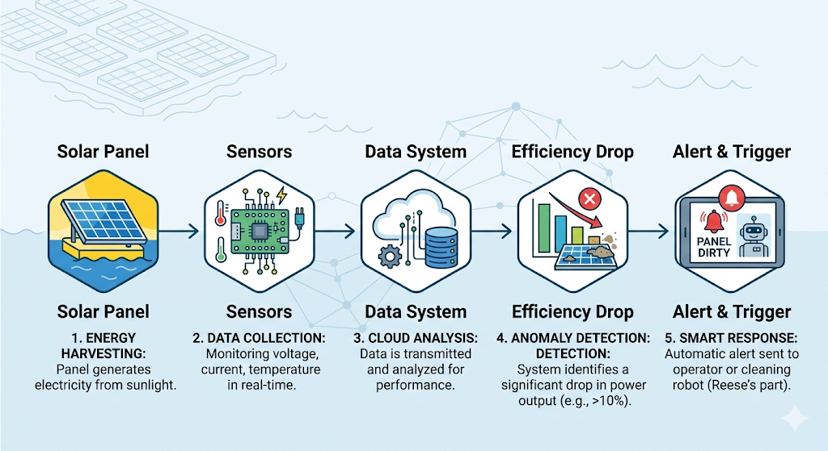
Detection System
Sensor Tracking
Monitors voltage, current, and power output
Efficiency Detection
Detects drops caused by dirt, salt, or debris
Smart Alerts
Sends alerts when panels need cleaning
Image generated using Gemini.

Slide 9
Cleaning Robot
Wheels or Track System
Further research will be done on if putting wheels on the robot or a track system will be more efficient.
Gentle cleaning process
This cleaning robot will use a combination of water and brushes to prolong their life cycle.
Interfaces with Detection System
It is communicated when and where to clean when the detection system sends an alert.
Charging / Refilling Dock
This robot will have a dock that it returns to when the it is not cleaning to refill water and keep the battery charged.

Slide 10
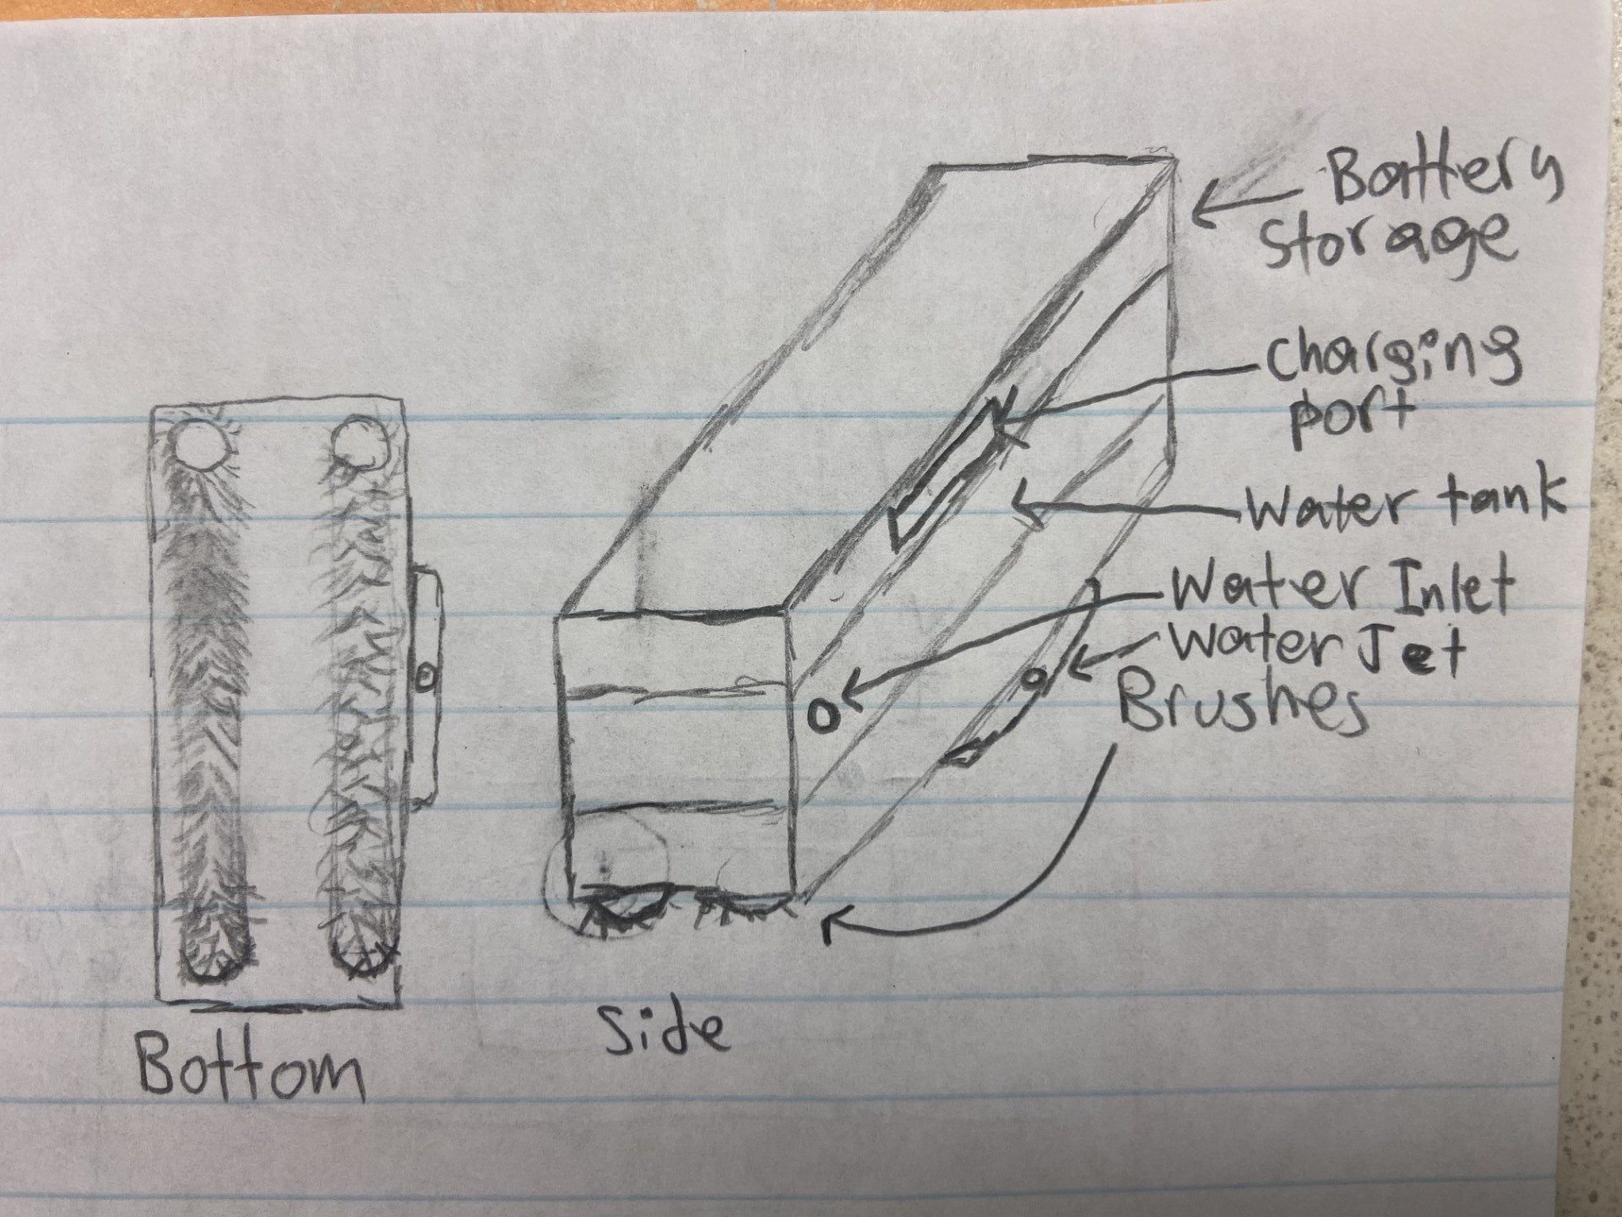
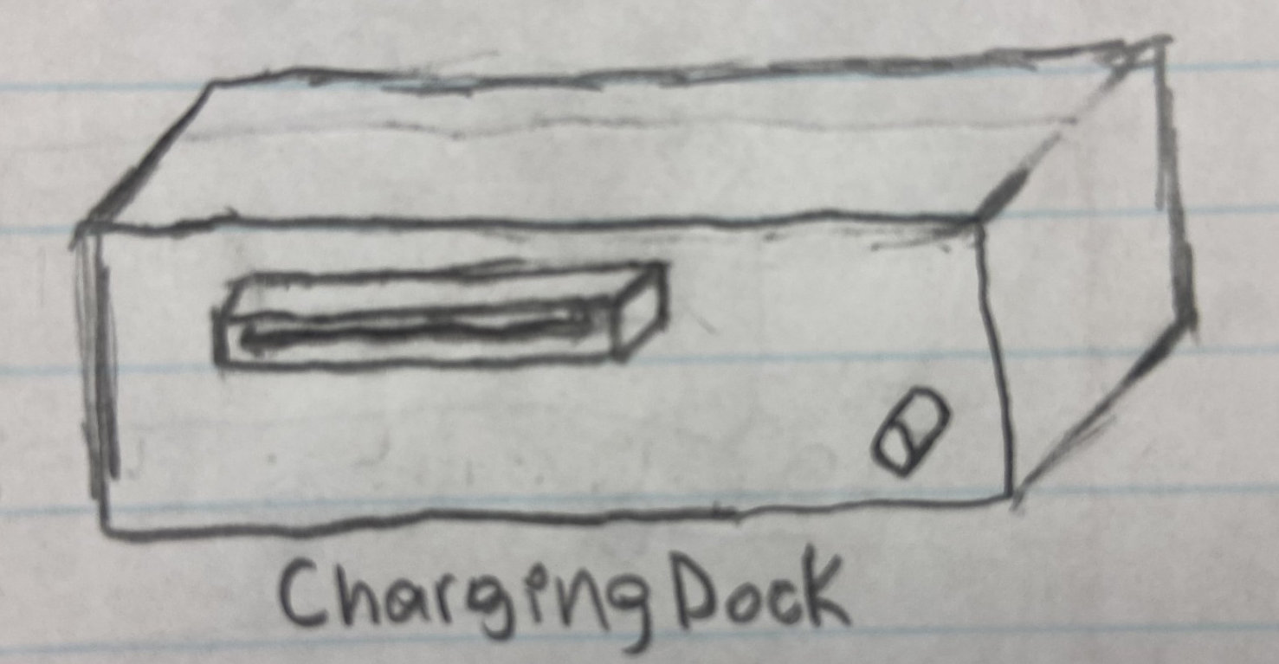
Cleaning robot Design
Illustration by Reese Harmeyer.
Illustration by Reese Harmeyer.

Slide 11
Review
The proposed floating solar farm design improves system efficiency
The improved design consists of:
Materials: HDPE, modified epoxy glass coating, and stainless steel
Mooring system: anchor, mooring line, and a wave barrier
Detection system: detects when solar panels need cleaned
Cleaning robot: automates solar panel cleaning

Slide 12
Conclusion
Floating solar farms benefit the public by providing a cleaner energy source
The proposed floating solar farm design improves durability, efficiency and maintenance
Future work could include:
Improving material selection and mooring system efficiency
Improving the cleaning robot design, such as adding wheels

Slide 13
Sources
Huang, L., Elzaabalawy, H., Sarhaan, M., Sherif, A., Ding, H., Ou, B., Yang, D., & Cerik, B. C. (2025). Developing reliable floating solar systems on seas: A review. Ocean Engineering, 322, Article 120525. https://doi.org/10.1016/j.oceaneng.2025.120525.
Jayaraman, T., Vijayakumar, M., Jayakumar, T., Murali, A., Karthikeyan, B., & Suriya, T. (2024). A conceptual design of remote controlled solar panel cleaning robot. 2024 5th International Conference on Smart Electronics and Communication (ICOSEC), Trichy, India, 387–391. https://doi.org/10.1109/ICOSEC61587.2024.10722191
Kekre, A., & Gawre, S. K. (2017). Solar photovoltaic remote monitoring system using IoT. International Conference on Recent Innovations in Signal Processing and Embedded Systems (RISE), Bhopal, India, 508–512. https://doi.org/10.1109/RISE.2017.8378210
Nedelcu, A.-T., Faităr, C., Voicu, I., & Panaitescu, M. (2026). Floating Photovoltaic Systems—Energy Performance and Environmental Challenges in Sustainable Development. Sustainability, 18(5), 2588. https://doi.org/10.3390/su18052588
Thangarasu, S. K., Gobinath, V. K., Shanmugam, A., Kumar, S. M., Shrinidhi, K. M., & Sanjay, S. (2024). Innovative Arduino-based solar panel cleaning system for enhanced energy efficiency. 2024 15th International Conference on Computing Communication and Networking Technologies (ICCCNT), Kamand, India, 1–5. https://doi.org/10.1109/ICCCNT61001.2024.10725904
Wen, Y., et al. (2025). The role of offshore wind and solar PV resources in global low-carbon transition. Science Advances, 11(11), Article eadx5580. https://doi.org/10.1126/sciadv.adx5580
Xiong, Y., Liu, H., Xu, J., & Chen, H. (2025). Mechanical properties of offshore floating photovoltaic structural coating/carbon steel system in a marine environment. Ocean Engineering, 323, Article 120585. https://doi.org/10.1016/j.oceaneng.2025.120585
Zeng, F., Bi, C., Sree, D., Huang, G., Zhang, N., & Law, A. W.-K. (2023). An adaptive barrier mooring system for coastal floating solar farms. Applied Energy, 348, Article 121618. https://doi.org/10.1016/j.apenergy.2023.121618

Slide 14
Contact Information
Acharya, Utsav – acharya.41@wright.edu
Evans, Daniel – evans.616@wright.edu
Gilliam, Erica – gilliam.55@wright.edu
Harmeyer, Reese – harmeyer.12@wright.edu
Rockenbaugh, Carter – rockenbaugh.3@wright.edu

